Slide 1
Effects of Modeling Choices on Plantarflexor Power
Jack Donohoe

Slide 2
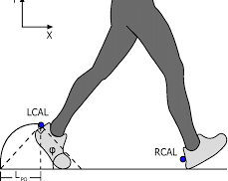
Scientific Problem
Accurate estimation of muscle fiber power in the plantarflexor muscles is essential for understanding push-off mechanics during gait and for designing effective assistive devices and prostheses.
Why this matters
Plantarflexors generate the largest mechanical power burst during walking
Errors in muscle modeling bias estimates of propulsion and metabolic cost
Influences gait analysis, rehabilitation planning, and prosthesis tuning

Slide 3
Key Muscles in Plantarflexor Muscles
Soleus
Gastrocnemius
Specifically the Gastrocnemius medial head

Slide 4
Aims of the Project
Aim: Determine how sensitive predicted plantarflexor fiber power is to modeling assumptions in tendon compliance and optimal fiber length.
Hypothesis: Variations in tendon compliance (±1 SD in tendon slack length) and muscle morphology (±1 SD in Fmax, Lopt, Lts, pennation) will significantly alter predicted plantarflexor fiber power, with tendon compliance changes primarily affecting fiber velocity and optimal fiber length changes affecting force production capacity.

Slide 5
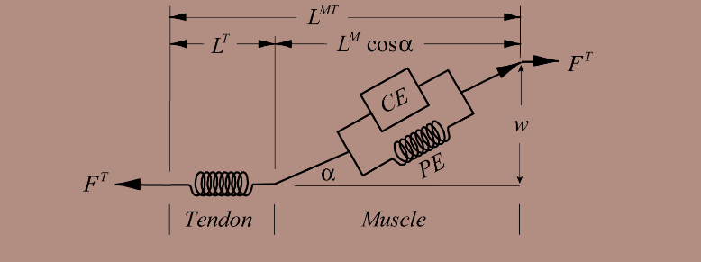
Important Dynamics
Hill Type Muscle Model

Slide 6
Tools Used
Rajagopal2016Model
Matlab
Lab 4 Static Optimization Framework
Musculotendon Parameters
Walking data, coordinates, generalized forces
Language used to run optimization and results
Already in place optimtimization code
Muscle specific STD values (Soleus and Gasmed)
(Rajagopal et al. 2016)

Slide 7
Simulation Workflow
1. Compute Kinematics & Generalized Forces
3. Fiber Dynamics and Power Calculation
2. Static Optimization
- Run OpenSim AnalyzeTool → joint angles & speeds
- Run Inverse Dynamics → joint moments
- Uses Millard2012 muscles with tendon compliance and activation dynamics disabled (static optimization)
Tendon slack length (Lts) variations still affect muscle operating length and force-length-velocity multipliers
- Extract fiber force and fiber velocity
- Compute fiber power = force × velocity
- Repeat for baseline, +SD morphology, –SD morphology, altered tendon compliance, altered optimal fiber length

Slide 8
Further look into Modeling Variants Tested
+1 SD Morphology
  Fmax, optimal fiber length (Lopt), tendon slack length (Lts), and pennation angle increased by +1 SD
–1 SD Morphology
  Same parameters decreased by –1 SD
+1 SD Tendon Compliance
  Tendon slack length increased by +1 SD (more compliant tendon)
–1 SD Tendon Compliance
  Tendon slack length decreased by –1 SD (stiffer tendon)

Slide 9
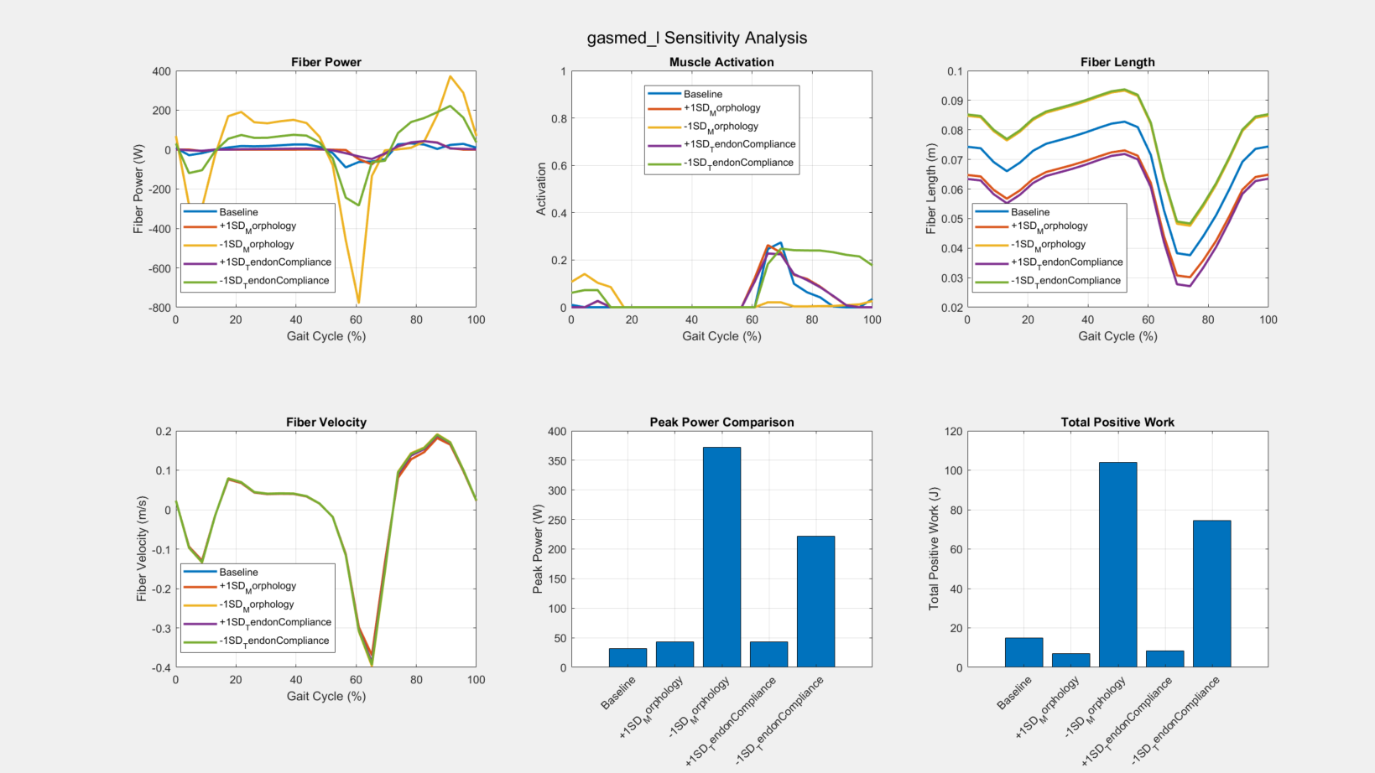
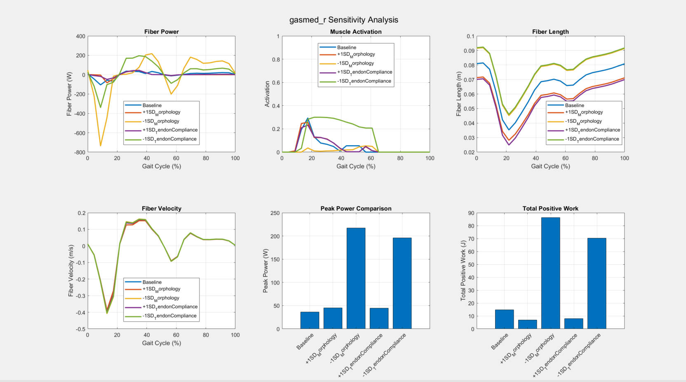
Results

Slide 10
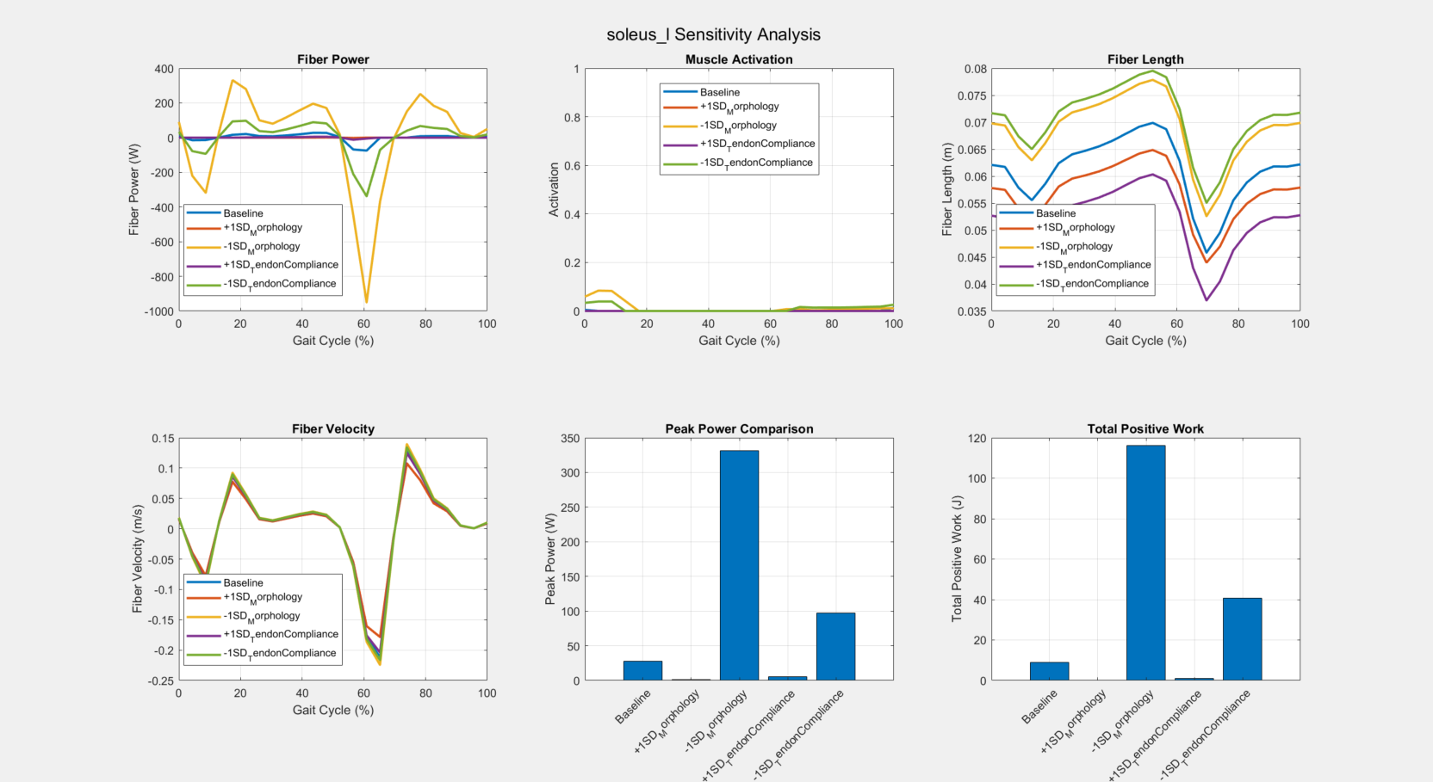
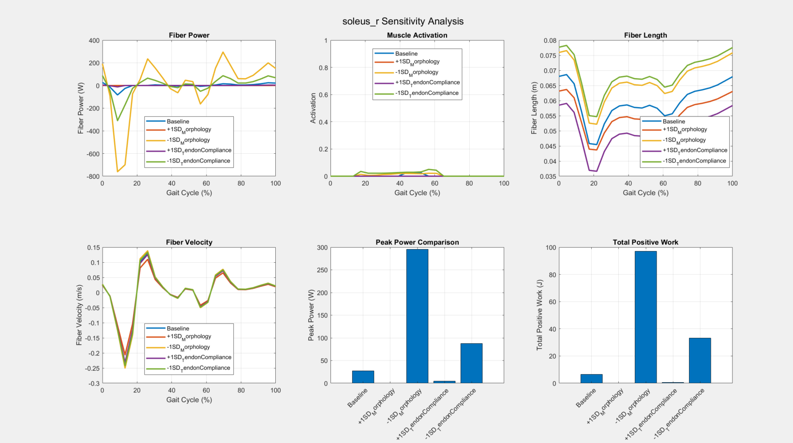
Results

Slide 11
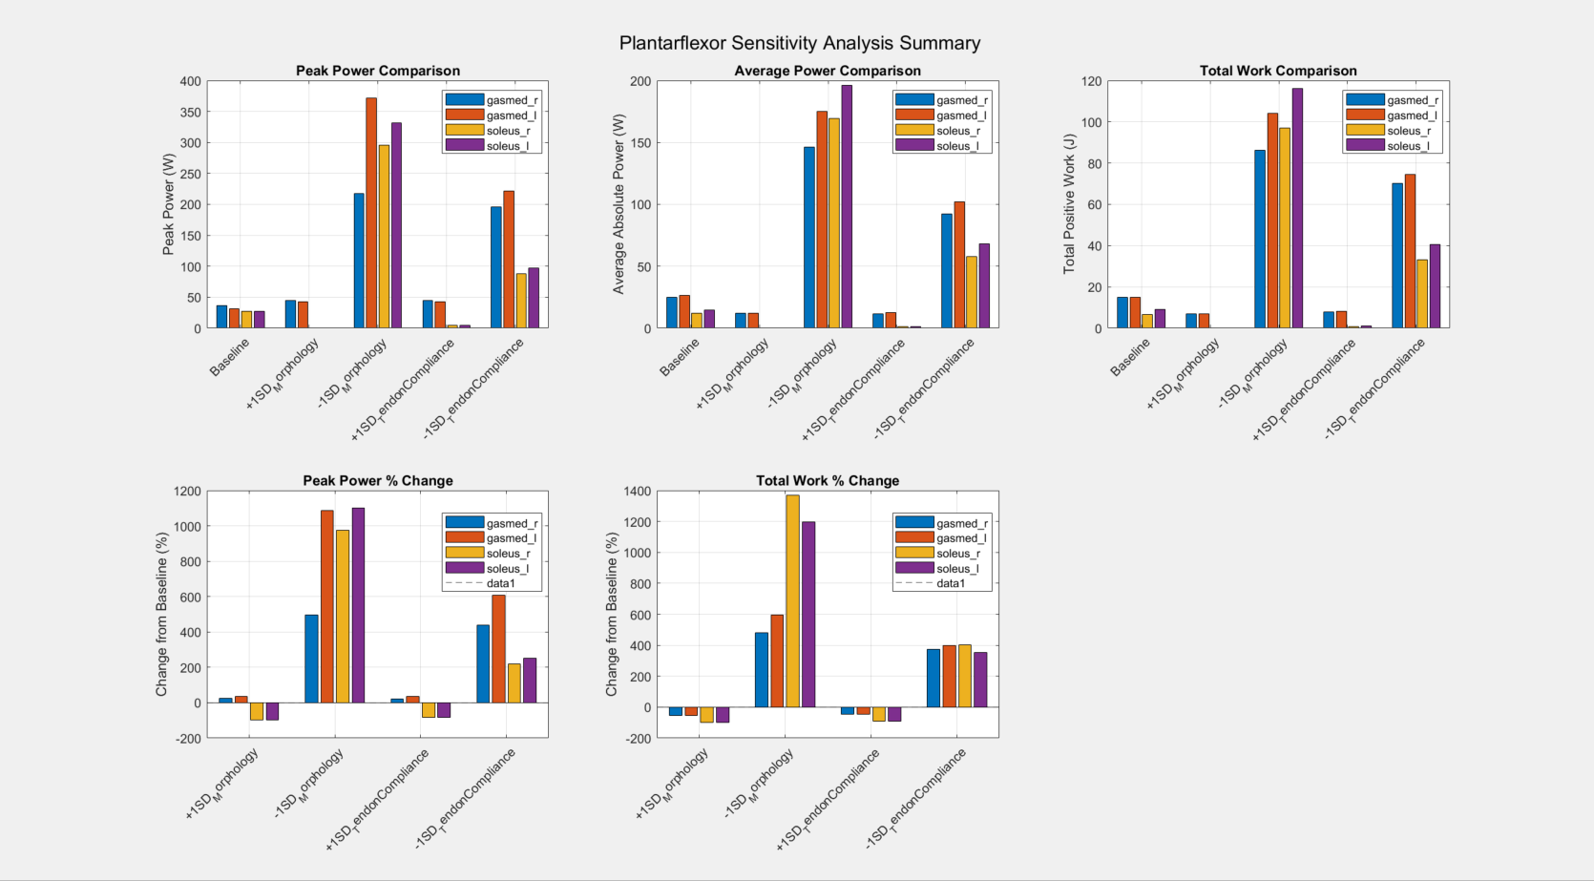
Results

Slide 12
Discussion
• Literature shows soleus and gastrocnemius fiber power peaks typically fall within ~100–150 W
• Peak fiber power depends strongly on modeling assumptions such as tendon compliance and optimal fiber length
• Improvement 1: Enable tendon compliance dynamics to capture series elastic effects and muscle-tendon interaction during push-off
• Improvement 2: Validate model predictions against subject-specific ultrasound or inverse-dynamics-based joint power
• Future direction: Use individualized morphology o to quantify robustness and apply results to prosthesis design

Slide 13
References
Arnold et al., 2013 – Muscle fiber lengths & velocities in walking/running. JEB.
Krishnaswamy et al., 2011 – Ankle muscle–tendon energetics in walking. PLOS Comp Bio.
Farris & Sawicki, 2012 – Gastrocnemius force–velocity behavior. PNAS.
Zajac, 1989 – Muscle and tendon modeling principles. Crit Rev Biomed Eng.
Uchida et al., 2016 – Simulating assistive devices & metabolic cost. PLOS ONE.
Lichtwark & Wilson, 2006 – Muscle–tendon interaction during locomotion. JEB.
Fukunaga et al., 2001 – In-vivo muscle–tendon behavior in walking. Proc R Soc B.
Rajagopal et al., 2016 – Full-body musculoskeletal model for simulation. IEEE TBME.
Neptune et al., 2001 – Muscle contributions to walking. J Biomech.

Slide 14
Thank You!
Questions?

